Slide 1
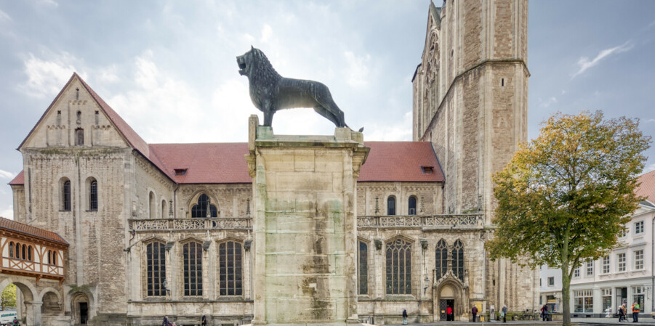
Name
Why is entrepreneurship important to you?
What is your motivation to join Start-up Camp 2023?
What are your academic and professional backgrounds?
Please also state the semester, university, and degree
Please introduce yourself and your team members
(who want to take part in the International Entrepreneurship Start-up Camp 2023)
Please apply individually to take part in the Camp if you want to join as a team. The second slide can be the same.
Why is Germany/Braunschweig a good environment for your start-up?
Under which requirements could you take part?
The participation fee will be approx. 700,00 € (including accomodation, meals and program) excluding flights. We are trying to get funding to further decrease the costs. For a better overview, please select one:
I could attend for the fulll price (program + flights)
I can only attend if if the main program is for free, but I pay for the flights
I can only attend if all expenditures are covered
I am a student at BITS and want to receive partial funding by DAAD
Please choose numbers 1, 2, 3 or 4: .
Where can we find out more about you?
Social Media (e.g. LinkedIn): optional
Phone:
Address:
E-Mail:

Slide 2
Name
What is the general problem that you want to solve with your business idea?
Please describe your business idea
How would the International Entrepreneurship Start-up Camp 2023 move your start-up project forward?
What is the status quo of your business? Which steps have you taken so far?
What are currently the main challenges you are facing as a start-up? In which areas would you like to meet potentials mentors/supporters ?
What next steps are you planning to take to develop your business?

